Slide 1
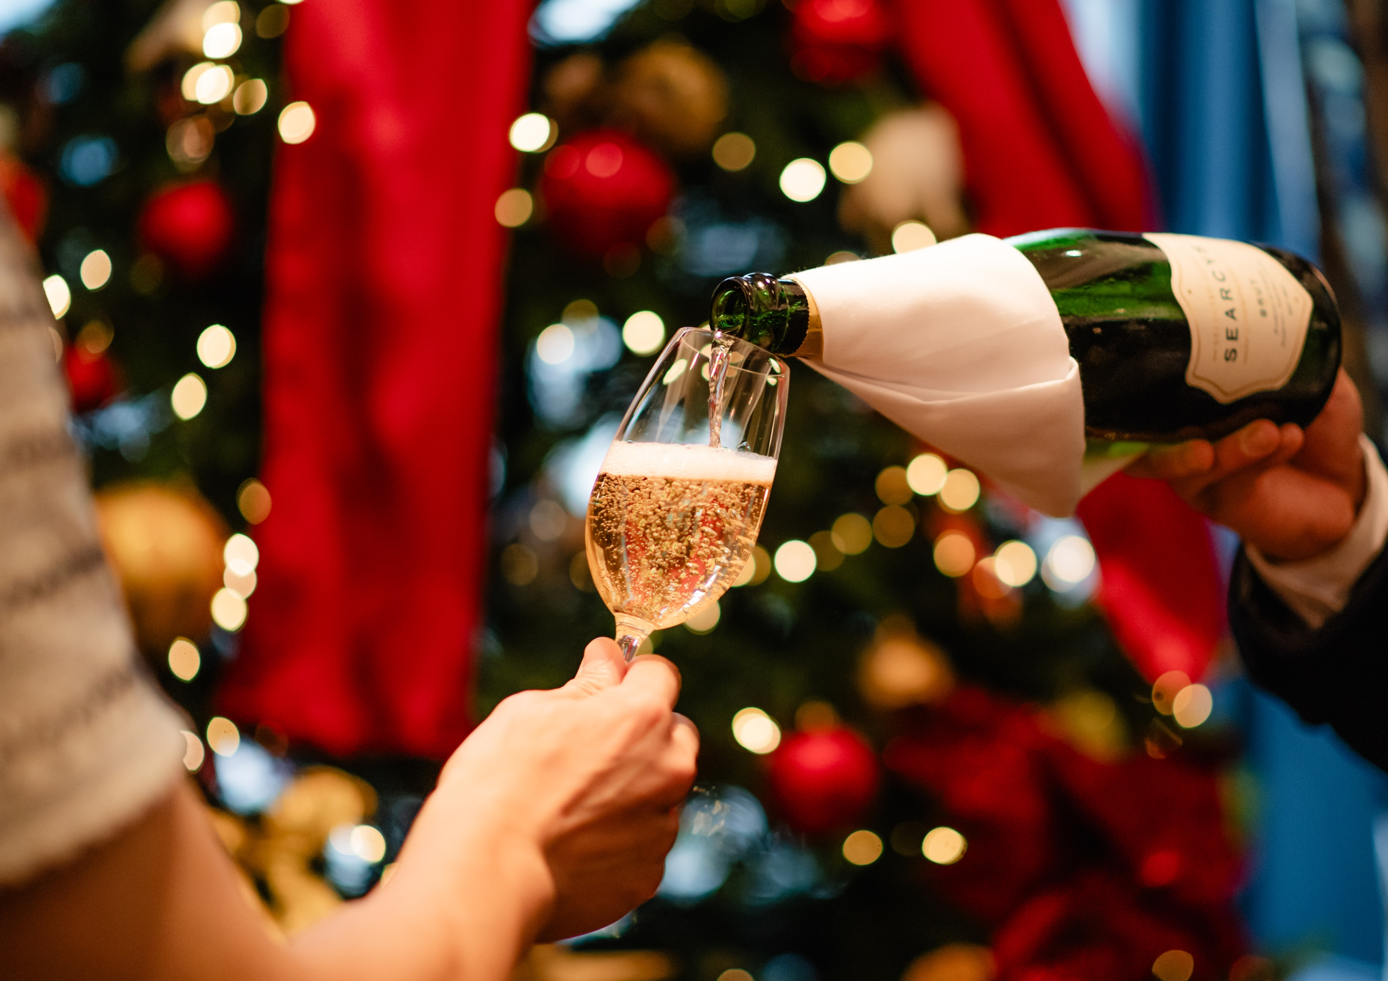
CHRISTMAS MENUS

Slide 2
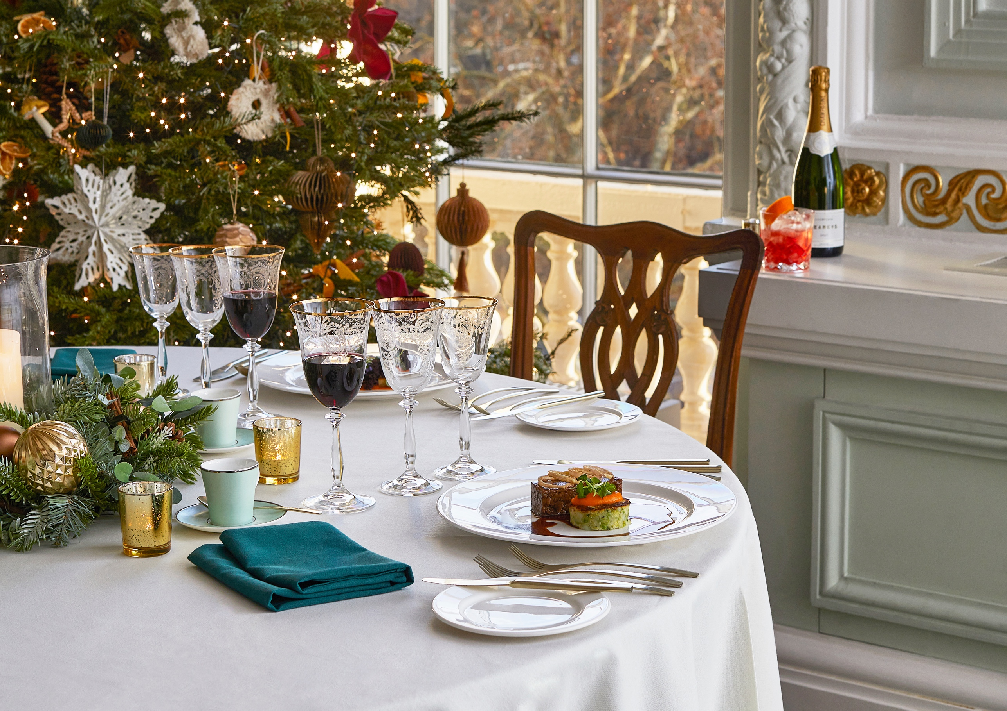
CELEBRATE IN
OUR CENTRAL
LONDON TOWNHOUSE
Located in the picturesque setting of Westminster, {10-11} Carlton House Terrace provides breath-taking views over St James’s Park and The Mall.
Enjoy intimate festive dining in your own private room or host an exclusive evening party, dancing the night away in the grand setting of our first floor overlooking the garden square.
Our wonderful catering partners Searcys will provide a sumptuous festive feast with a seasonal and sustainably sourced menu and no party is complete without music to dance the night away and Blank Canvas Entertainment will ensure that no one leaves the dance floor.
Like the beautiful building of {10-11} Carlton House Terrace, Searcys have a long and illustrious history since being established in 1847 by the chef to the Duke of Northumberland.
When you come to {10-11} Carlton House Terrace you can rest assured that your event will be in safe hands. Searcys will work with you to plan your occasion and ensure that your guests’ expectations are exceeded. Their experience will be at your disposal at all times during the planning process and on the big day.

Slide 3
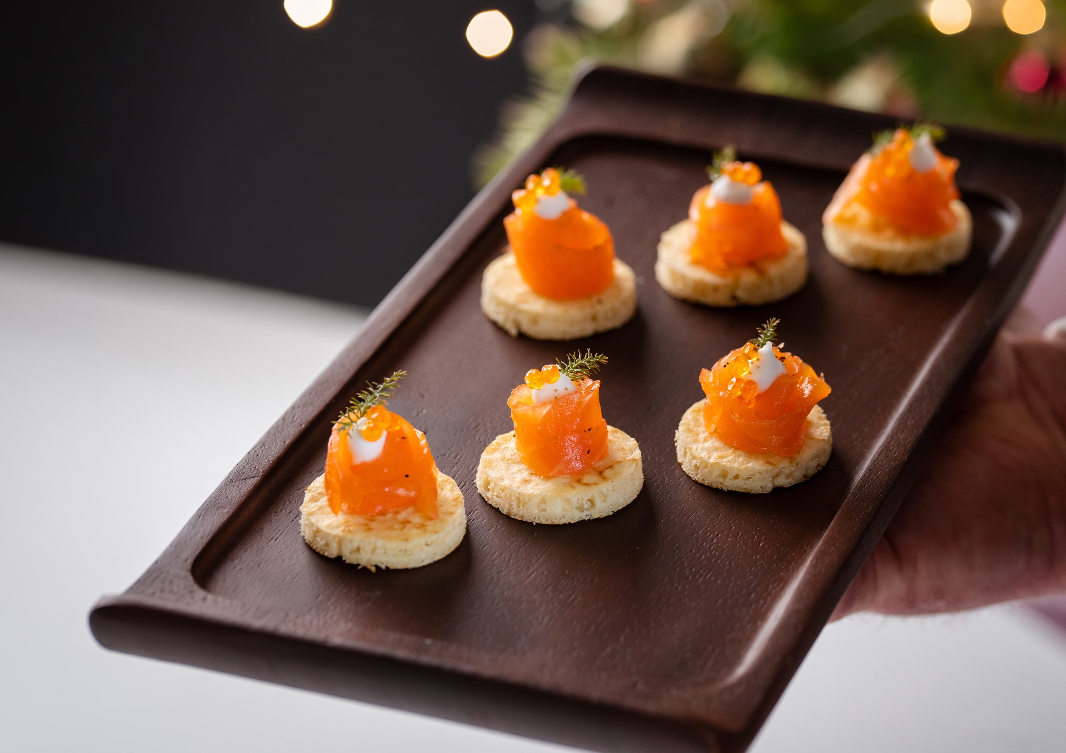
CANAPÉS
HOT CANAPÉS
Celeriac croquette, quince, pickled apple (ve)
Winter root rösti, parsnip puree, cranberry (ve)
Pressed lamb, spiced blood orange, mint
Slow braised ox cheek bonbon, horseradish cream, pickled shallots
COLD CANAPÉS
Heritage beetroot macaroon, Lord London, candied pumpkin seeds (v)
Wild mushroom and tarragon tart,
thyme jelly (ve)
Smoked Chalk Stream trout rillette, soda bread sable, pickled fennel, seaweed jelly
Crispy chicken skin, chicken parfait,
winter fruit chutney
SWEET CANAPÉS
Mini minced pie, brandy chantilly (v)
Blackcurrant pâté de fruit (ve)
Salted caramel bon bon (v)
(ve) Vegan (v) Vegetarian (gf) Gluten-free

Slide 4
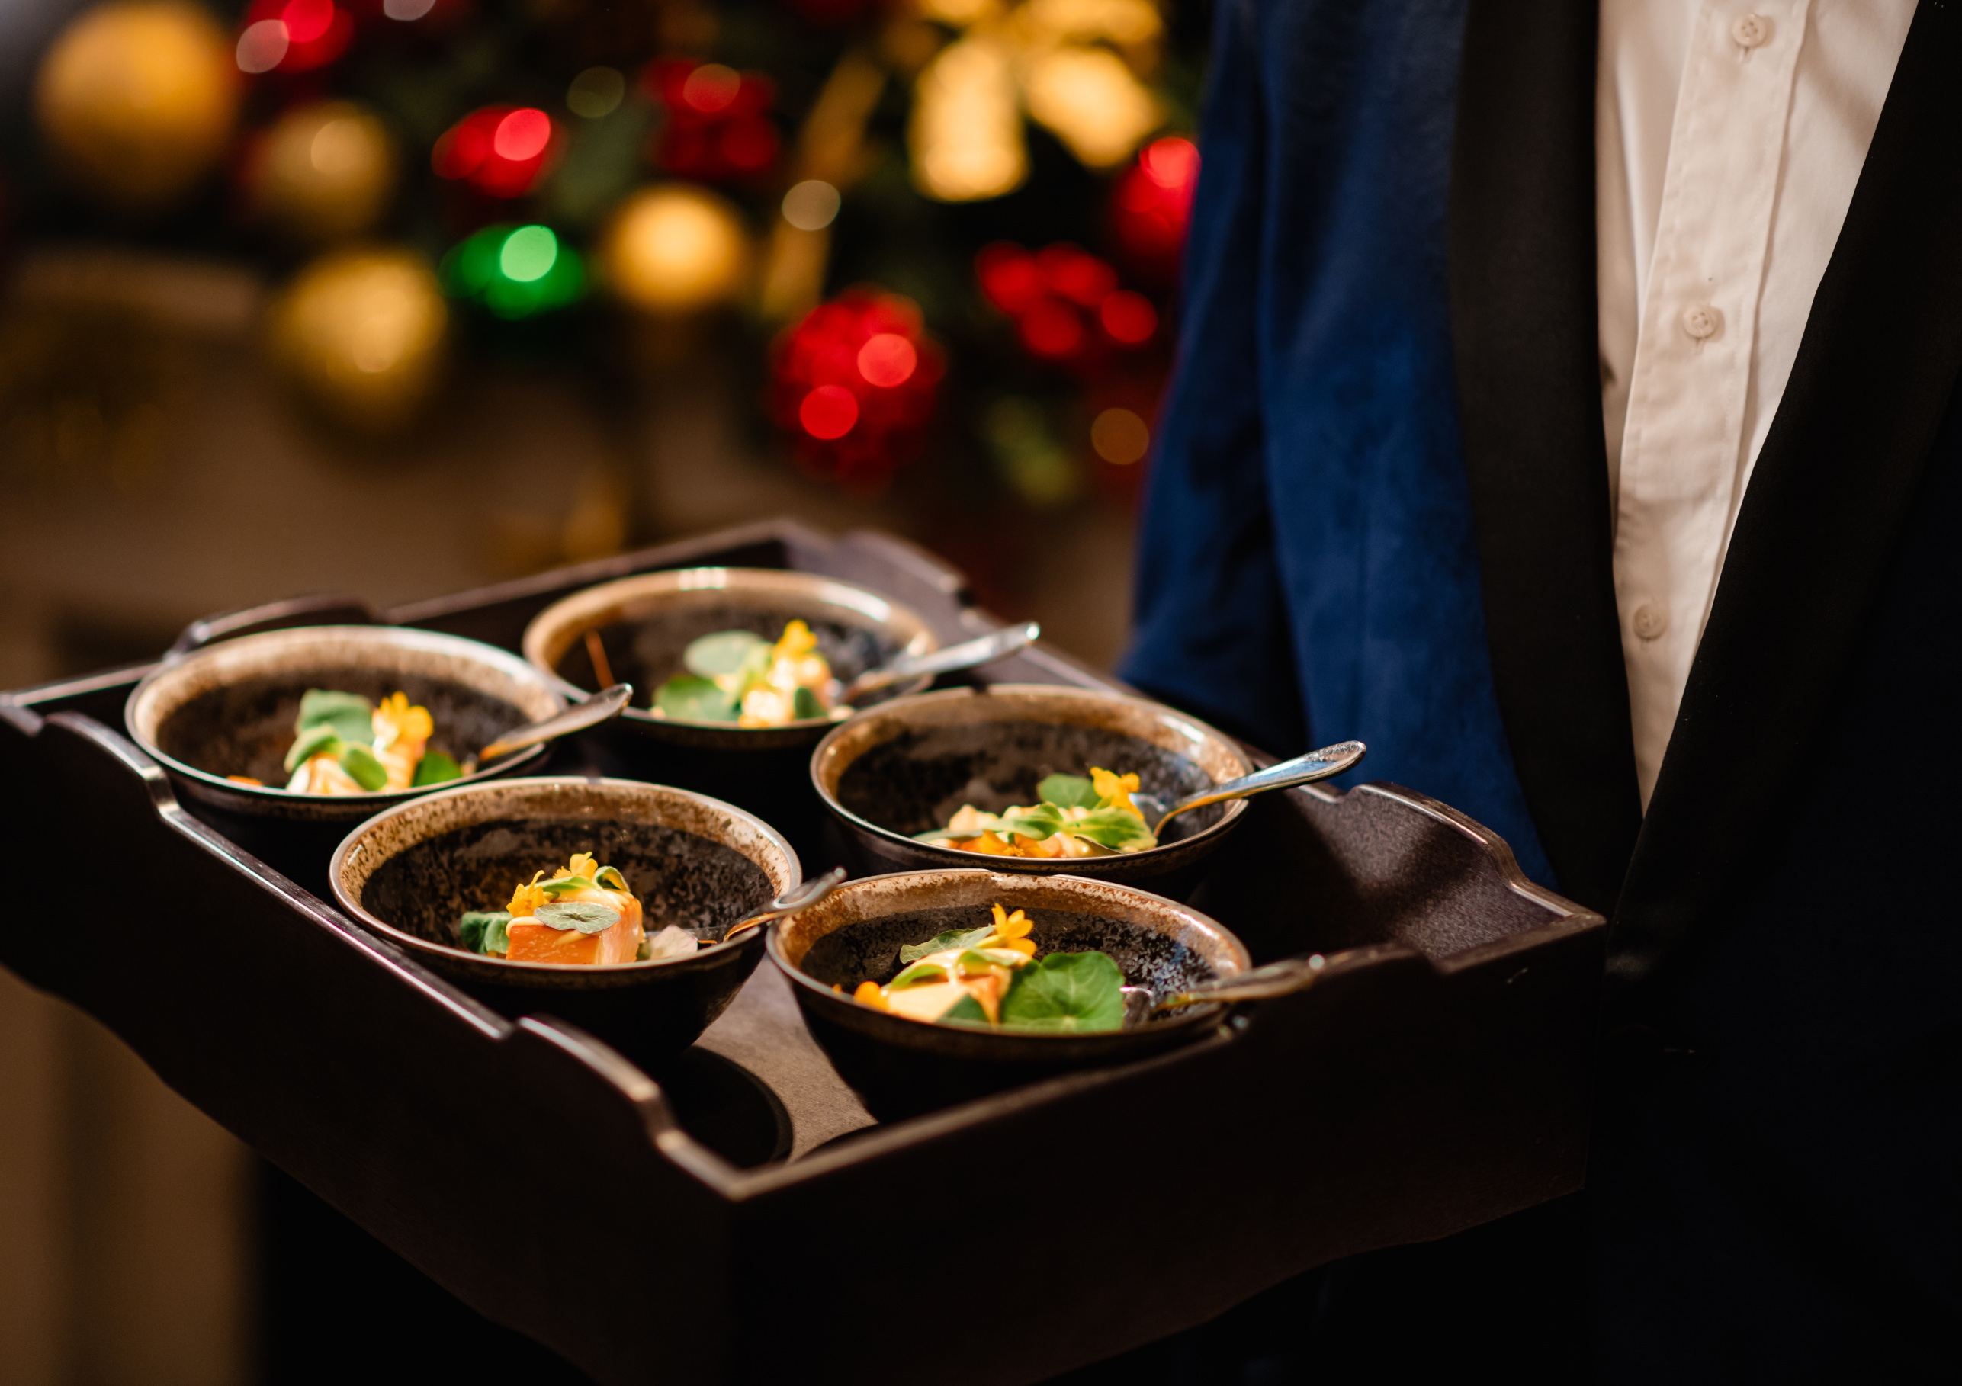
BOWL FOOD
HOT
Norfolk turkey, roast potatoes, root vegetables,
turkey jus
Pigs in blankets, pomme puree, crispy shallots,
red wine jus
Cornish hake, parsnip puree, pickle fennel,
salsa verde
Slow roasted celeriac, winter root tops, confit
shallot, chestnut, winter truffle cream sauce (ve)
COLD
Beetroot gravlax, celeriac, fennel salad,
mustard dill dressing
Herb marinated artichoke hearts, puy lentils,
yellow split peas, mint yoghurt (ve)
DESSERTS
Red velvet, honeycomb chocolate log (v)
Green apple panna cotta, Viennese biscuit,
red currants (ve)
Caramelised spiced clementine bread and
butter pudding (v)
(ve) Vegan (v) Vegetarian (gf) Gluten-free

Slide 5
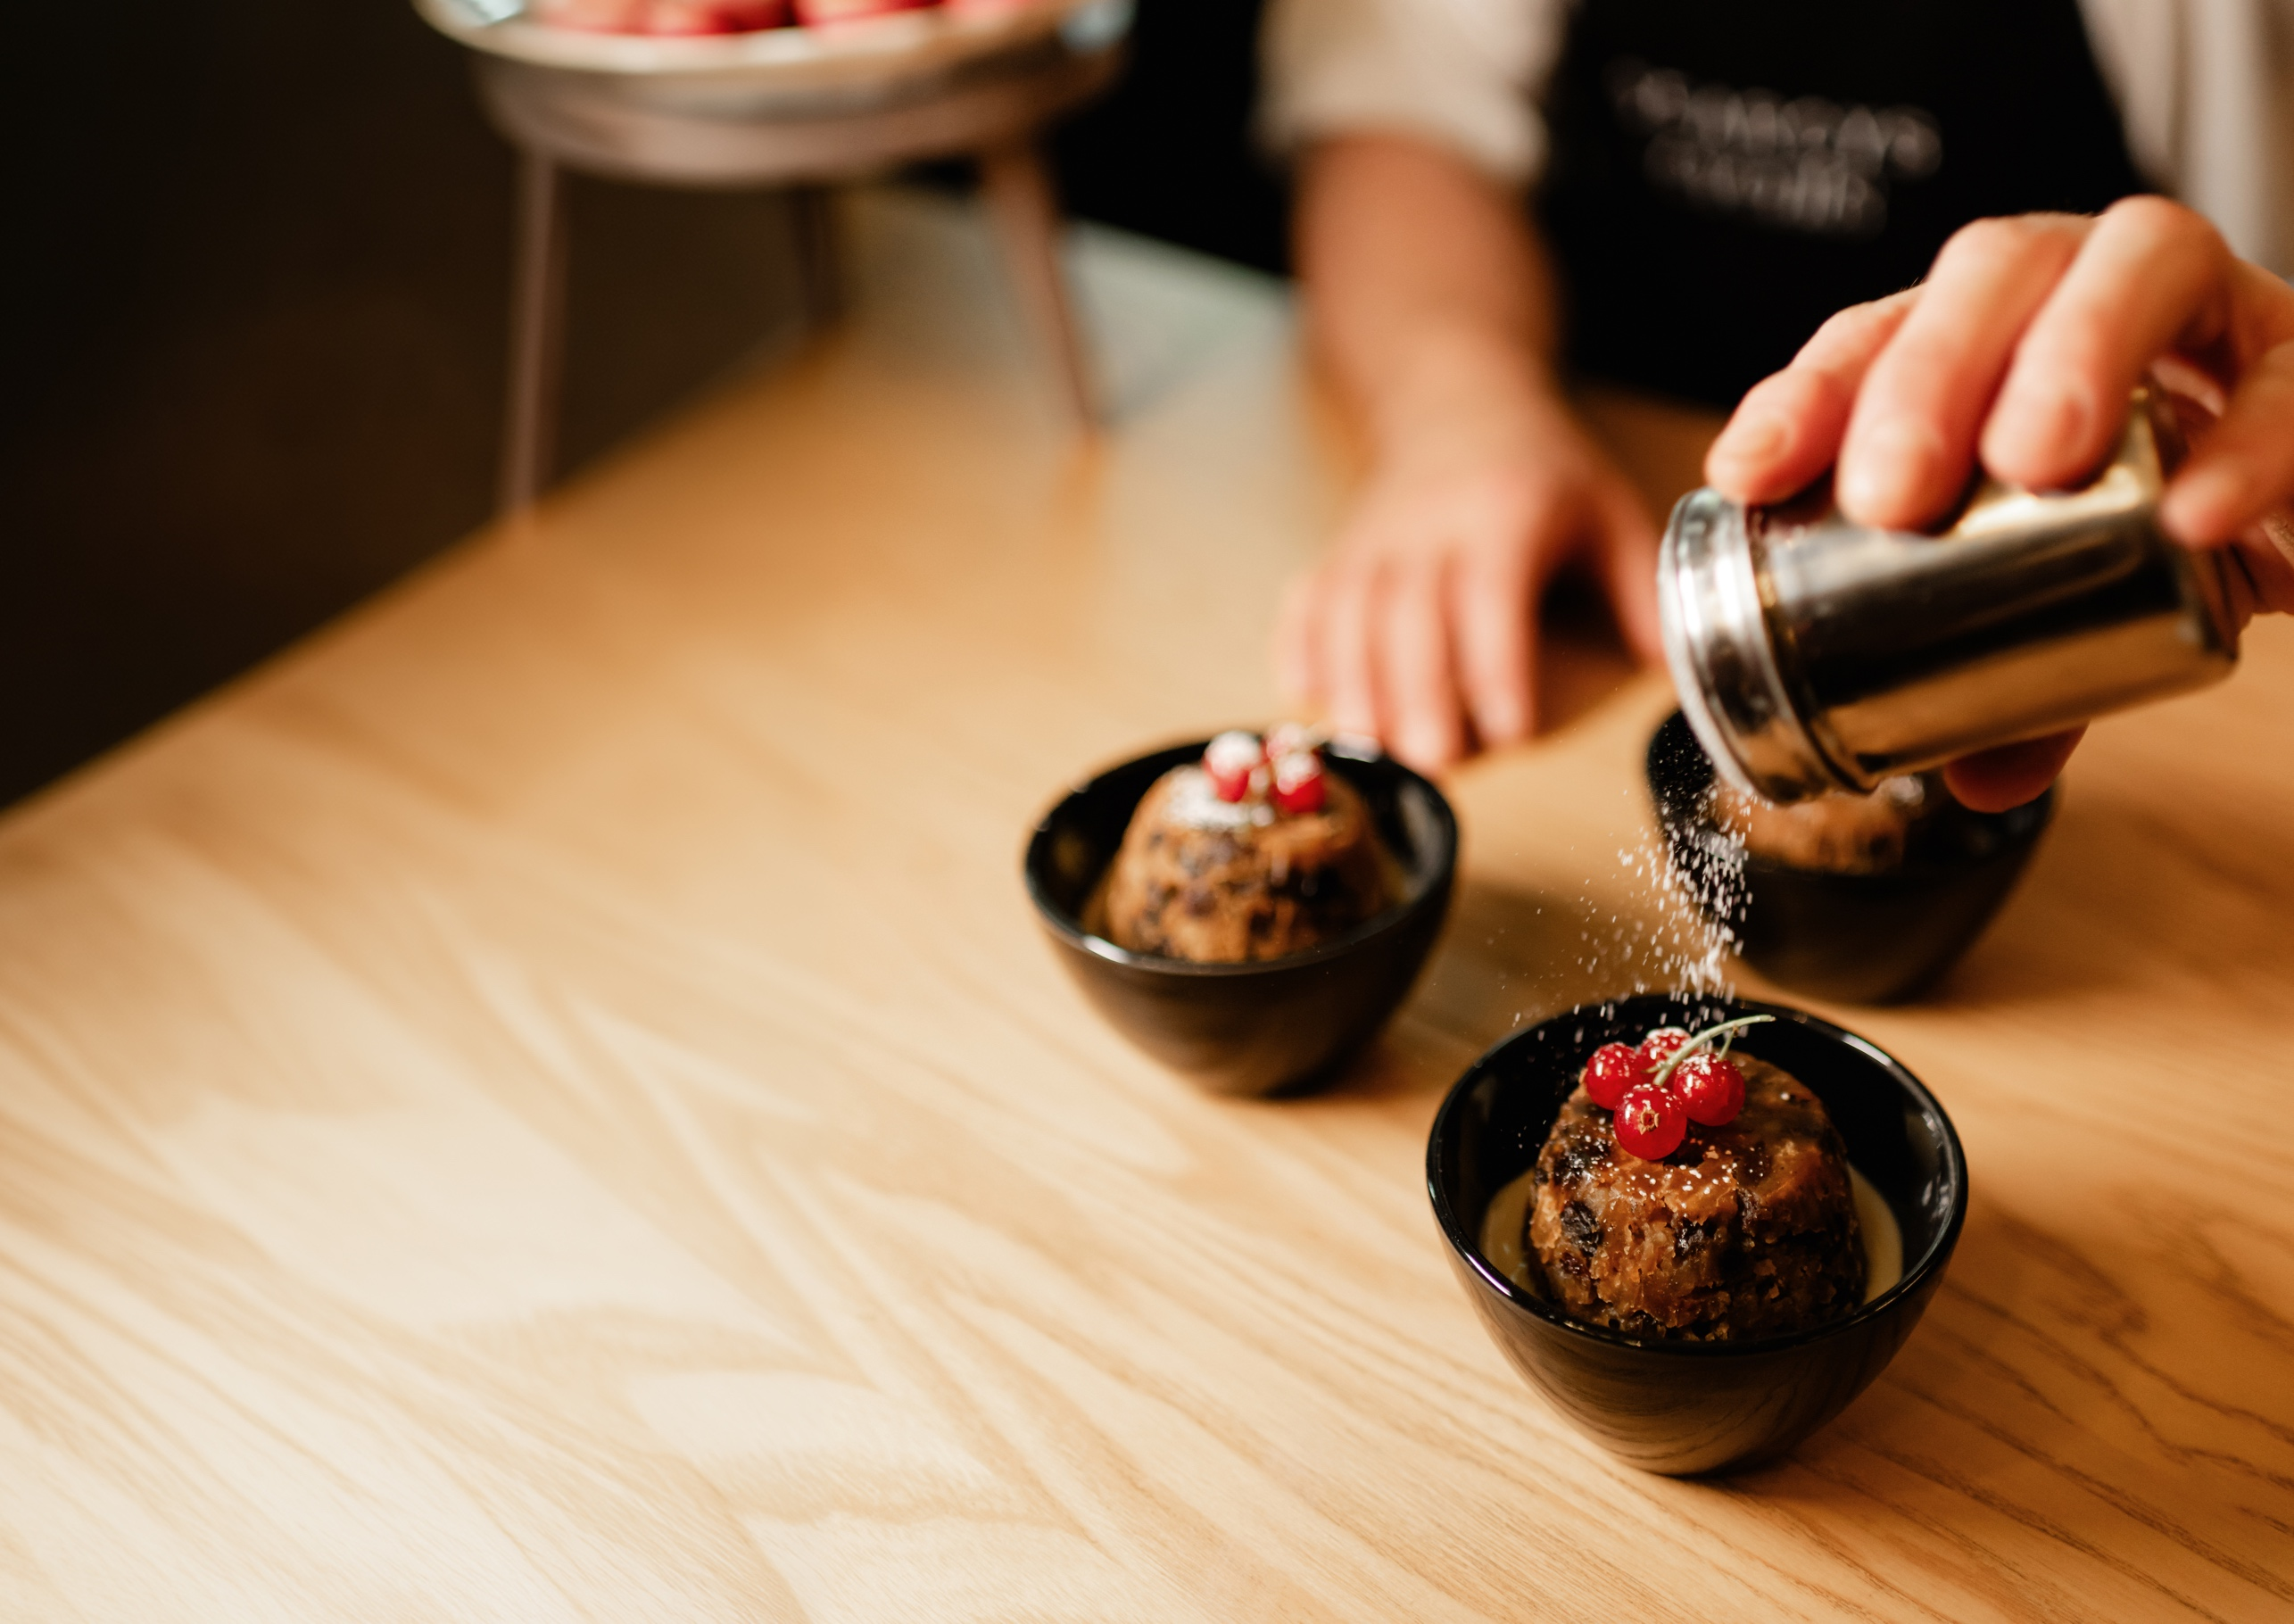
HOT FORK BUFFET
SET MENU
MAINS
Norfolk turkey breast, roast potatoes, winter
root veg, cranberry sauce, turkey jus
Celeriac and wild mushroom Wellington,
braised cavolo nero, roasted parsnips,
red wine shallot jus (ve)
SALADS
Red cabbage, chicory, apple and goat’s cheese salad, lemon mustard vinaigrette
Sweet potato, chickpea, vegan feta, tahini, mint yoghurt (ve)
DESSERT
Christmas pudding, brandy custard (v)
Black forest chocolate delice, brandied
cherries, chantilly (v)
Blackberry mille-feuille, clementine cream, soaked clementines, orange tuille (ve)
(ve) Vegan (v) Vegetarian (gf) Gluten-free

Slide 6
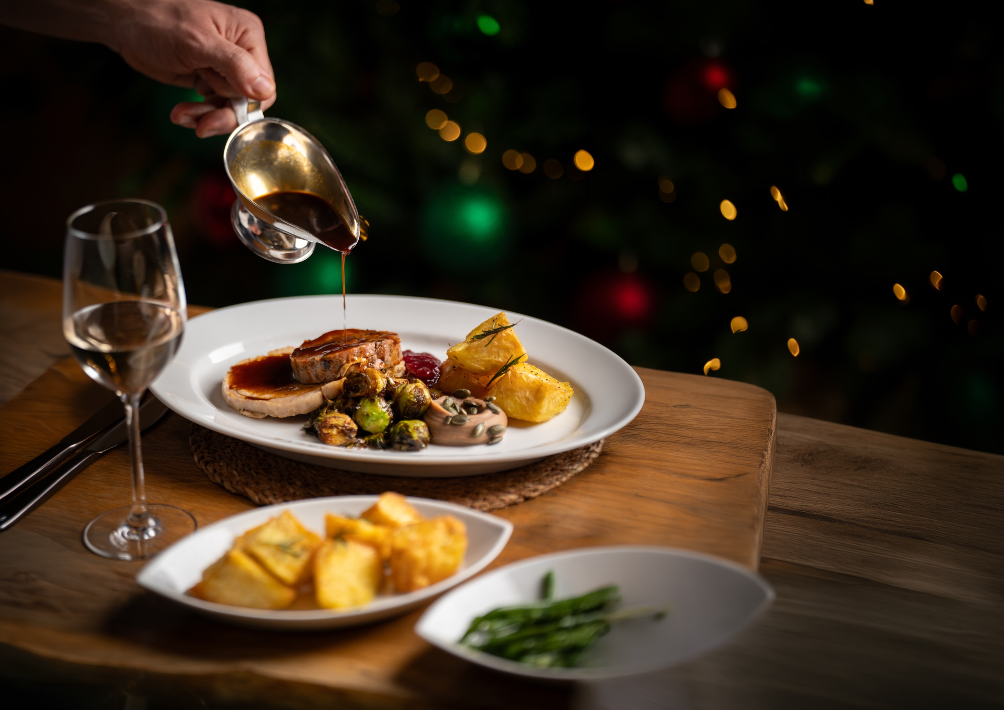
SEATED DINNER
Choose one starter, two mains (one meat/fish
and one vegetarian) and one dessert
STARTERS
Mushroom parfait, pickled mushrooms, sourdough crisp (ve)
Roasted delica pumpkin, pumpkin velouté, sage oil, pumpkin seeds, Yorkshire blue cheese (v)
Chalk Stream smoked trout, beetroot carpaccio, goat’s cheese mousse, toasted pine nuts, dill and caper dressing
MAINS
Norfolk turkey breast, truffle and sage stuffing, pigs in blankets, roasted potatoes, honey glazed carrots, parsnips, Brussels sprouts, chestnut, turkey jus
Cornish hake, Jerusalem artichoke parmentier, confit shallots, Pitchfork Cheddar cheese sabayon
Celeriac and wild mushroom Wellington, braised cavolo nero, parsnip puree, red wine shallot jus (ve)
DESSERT
(plated or served as a dessert station)
Christmas pudding, brandy custard (v)
Black forest chocolate delice, brandied cherries, chantilly (v)
Blackberry mille-feuille, clementine cream,
soaked clementines, orange tuille (ve)
(ve) Vegan (v) Vegetarian (gf) Gluten-free

Slide 7

LET’S GET FESTIVE
YOU CAN SPEAK TO US IN A NUMBER OF WAYS
Thank you for your enquiry and we hope that our menus excite you.
We are very happy to discuss your requirements and to talk through any bespoke options that you may be interested in.
Call us 020 7969 5224
Email us info@10-11cht.co.uk
Visit our social media pages for some venue inspiration!
@1011cht
@10.11CarltonHouseTerrace
@1011chtevents

